Slide 1

Can you tell which numbers are statistically extreme points (AKA outliers) ? 52, 48, 45, 44, 49, 55, 40, 46, 44, 53, 47, 47, 48, 52, 48, 34, 52, 52, 48, 44, 51, 51, 47, 48, 45, 49, 42, 52, 45, 51, 42, 47, 49, 41, 50, 48, 41, 43, 53, 54, 28, 31, 68, 75, 74

Slide 2
Problems with outliers
Mean:
3, 3, 4, 5, 5, 7 => mean = (3 + 3 + 4 + 5 + 5 + 7) / 6 = 4.5
3, 3, 4, 5, 5, 70 => mean = (3 + 3 + 4 + 5 + 5 + 70) / 6 = 15
Presence of outliers changed the mean value drastically
Median are not affected by presence of outliers:
3, 3, 4, 5, 5, 7 => median = (4 + 5) / 2 = 4.5
3, 3, 4, 5, 5, 70 => median = (4 + 5) / 2 = 4.5

Slide 3
Identify outliers: Using IQR method
Step1: Order the dataset:
Actual dataset:
52, 48, 45, 44, 49, 55, 40, 46, 44, 53, 47, 47, 48, 52, 48, 34, 52, 52, 48, 44, 51, 51, 47, 48, 45, 49, 42, 52, 45, 51, 42, 47, 49, 41, 50, 48, 41, 43, 53, 54, 28, 31, 68, 75, 74
Ordered dataset:
28, 31, 34, 40, 41, 41, 42, 42, 43, 44, 44, 44, 45, 45, 45, 46, 47, 47, 47, 47, 48, 48, 48, 48, 48, 48, 49, 49, 49, 50, 51, 51, 51, 52, 52, 52, 52, 52, 53, 53, 54, 55, 68, 74, 75

Slide 4
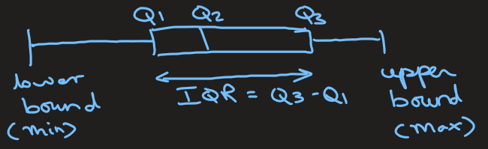
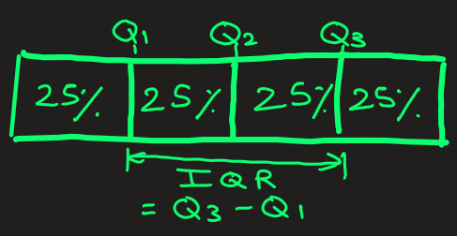
Identify outliers: Using IQR method
Step2: Find Q1, Q3 and IQR
28, 31, 34, 40, 41, 41, 42, 42, 43, 44, 44, 44, 45, 45, 45, 46, 47, 47, 47, 47, 48, 48, 48,
48, 48, 48, 49, 49, 49, 50, 51, 51, 51, 52, 52, 52, 52, 52, 53, 53, 54, 55, 68, 74, 75
Here Q1 = 44, and Q3 = 52.
IQR = Q3 – Q1 = 52 – 44 = 8

Slide 5
Identify outliers: Using IQR method
Step3: Identify Lower and upper bound
Lower bound = Q1 − 1.5 × IQR = 44 – 1.5 x 8 = 32
Upper bound = Q3 + 1.5 × IQR = 52 + 1.5 x 8 = 64
Step4: Points outside the lower and upper bound are outliers.
Outliers = 28, 31, 68, 74, 75. These values represent
statistically extreme points in the dataset.

Slide 6
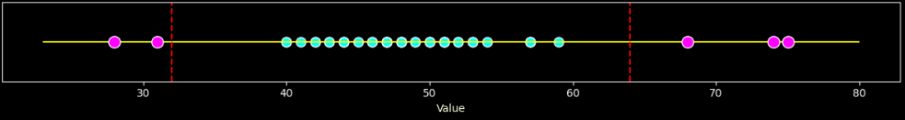
Identify outliers: Final Result
Ordered dataset:
28, 31, 34, 40, 41, 41, 42, 42, 43, 44, 44, 44, 45, 45, 45, 46, 47, 47, 47, 47, 48, 48, 48, 48, 48, 48, 49, 49, 49, 50, 51, 51, 51, 52, 52, 52, 52, 52, 53, 53, 54, 55, 68, 74, 75

Slide 7

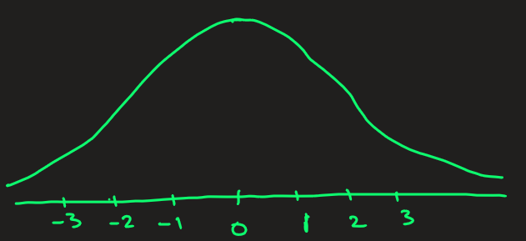
Identify outliers: Using z-score method
2 step process:
Step 1: Convert your data into z-score. The z-score measures how many standard deviations a data point is from the mean.
Step 2: Set up your threshold (commonly 3), and if |Z| > threshold, it’s considered an outlier.
Example: Find outliers in following data.
28, 31, 34, 40, 41, 41, 42, 42, 43, 44, 44, 44, 45, 45, 45, 46, 47, 47, 47, 47, 48, 48, 48, 48, 48, 48, 49, 49, 49, 50, 51, 51, 51, 52, 52, 52, 52, 52, 53, 53, 54, 55, 68, 74, 75
Step1: After calculation, mean μ = 48.28 and
std. dev. σ = 8.53
Data -> z-score
-> (28 – 48.28) / 8.53 = -2.38
-> (31 - 48.28) / 8.53 = -2.03
34 -> (34 - 48.28) / 8.53 = -1.67 and so on.

Slide 8
Identify outliers: Using z-score method
Sorted Dataset:
28, 31, 34, 40, 41, 41, 42, 42, 43, 44, 44, 44, 45, 45, 45, 46, 47, 47, 47, 47, 48, 48, 48, 48, 48, 48, 49, 49, 49, 50, 51, 51, 51, 52, 52, 52, 52, 52, 53, 53, 54, 55, 68, 74, 75
Z-scores:
-2.38, -2.03, -1.67, -0.97, -0.85, -0.85, -0.74, -0.74, -0.62, -0.5, -0.5, -0.5, -0.39, -0.39, -0.39, -0.27, -0.15, -0.15, -0.15, -0.15, -0.03, -0.03, -0.03, -0.03, -0.03, -0.03, 0.08, 0.08, 0.08, 0.2, 0.32, 0.32, 0.32, 0.43, 0.43, 0.43, 0.43, 0.43, 0.55, 0.55, 0.67, 0.79, 2.31, 3.01, 3.13
Step2: Let’s define threshold = 2.3
Detected Outliers (z < -2.3 or z > +2.3):
28, 68, 74, 75

Slide 9
IQR method or z-score method ?
IQR method is best for:
Non-normal (skewed) or small datasets (e.g. 3, 2, 4, 1, 3, 4, 93)
Data with unknown distribution
Ordinal or not strictly continuous data (e.g. 3, 2, 4, 1,3, 4, 93)
Z-score method best for:
Normally distributed (bell-shaped) data
Continuous and large datasets (e.g. 1.12, 2.34, 3.12, 1.94, …. )

Slide 10
How to remove outliers ? Few basic techniques
Trim them: - 40, 1, 1, 2, 2, 2, 2, 2, 3, 4, 4, 5, 56, 89
1, 1, 2, 2, 2, 2, 2, 3, 4, 4, 5
If outliers are due to data entry errors or measurement mistakes, you can safely remove them.
Best for: clear, obvious outliers not representing true behavior.
B) Cap or Winsorize them: - 40, 1, 1, 2, 2, 2, 2, 2, 3, 4, 4, 5, 56, 89
1, 1, 1, 2, 2, 2, 2, 2, 3, 4, 4, 5, 5, 5
Instead of removing, you limit extreme values to a threshold.
Best for: preserving dataset size and avoiding bias.
C) Replace with mean/median (Imputation): - 40, 1, 1, 2, 2, 2, 2, 2, 3, 4, 4, 5, 56, 89
M, 1, 1, 2, 2, 2, 2, 2, 3, 4, 4, 5, M, M
You can replace extreme values with more typical ones.
Best for: small datasets where every record matters.

Slide 11
STOP

Slide 12
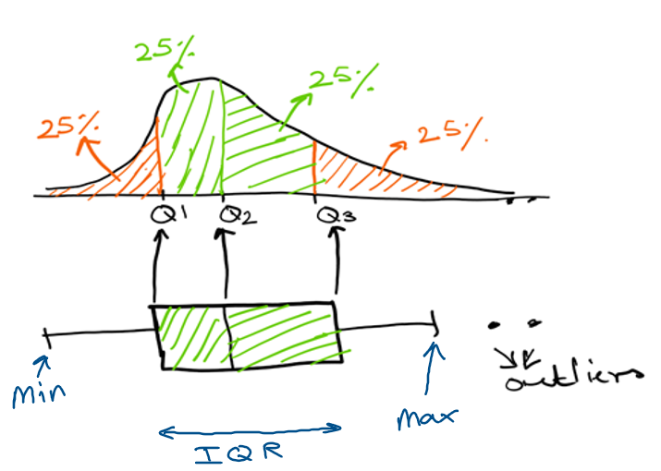
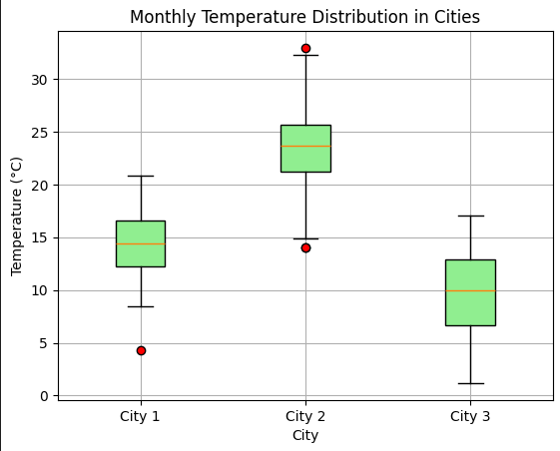
Box plots
Show distributions of numeric data values, especially when you want to compare them between multiple groups.
Provide visuals on data’s symmetry, skew, variance, and outliers.
4, 3, 5, 2, 4, 3, 6, 7, 8, 3, 5, 2, 3, 4, 78, 3, 2,-30, 3, 4, 5, 3, 2: here -30 and 78 seem outliers
Easy to see where the main bulk of the data is, and make that comparison between different groups.
25% of data falls below Q1 (quartiles)
50% of data falls below Q2
75% of data falls below Q3
For city1:
most of temp is between 13 to 16. There is one outlier, temp = 4
Q1 = 13. So 25% of temp data falls below 13.
Q2 =14. So 50% of temp data falls below 14
Q3 = 17.

Slide 14
STOP

